Slide 1
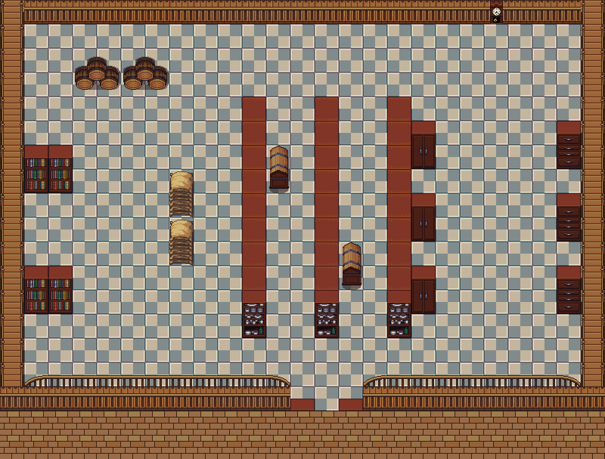
Group C5
Members: Anas, Ervis, Callum, Ben and Jordan
Bargain Hunter

Slide 2
Program Essentials
Coins placed across a map (4 screens) which the player collects to buy items
The more coins the player chooses to cash in at a store the shopkeeper is able to search for longer
Multiple stores which the player can buy items from
Once all items player desires are bought they can then proceed to checkout
A* Algorithm was our chosen searching algorithm and is essential to our game, as it allowed our program to define the fastest possible route to reach the users selected product/item
Insertion sort was also implemented in order to organize the items which the user collects/has collected

Slide 3
Problem Resolution
Initially we struggled on making a start and making the first steps writing a program
Our previous background image caused issues when we tried to implement scrolling, cutting off parts of the game
Unit collision in map, the user-controlled character clashes with some objects but not others
We then conducted some individual research and following a discussion came to a conclusion to use Pygame
In order to fix this problem and retain the same background image we removed the scrolling feature from the game and implemented multiple screens
Revised code to have higher unit-detection

Slide 4
What We've Learnt
Learnt to delegate roles amongst the group in order to complete tasks efficiently
Acquired fundamental teamwork skills which we can then transition into our working careers
How to implement a searching and sorting algorithm
How to use Github to manage resources, collaborate and edit our program
How to operate in Python GUI

Slide 5
What We Have Achieved As a Group
We were able to communicate regularly as a group and develop/discuss any ideas which group members had which in turn improved our final product
We were able to keep our repository up to date so that members could easily monitor progress and collaborate at any time
Each member of the group was able to complete the tasks associated to them which in-turn improved the final product
We successfully created a search and sort bargain hunt game (kinda)

Slide 6
Demonstration
Demo

